Slide 1
More Graph Theory
Epic Algorithms

Slide 2
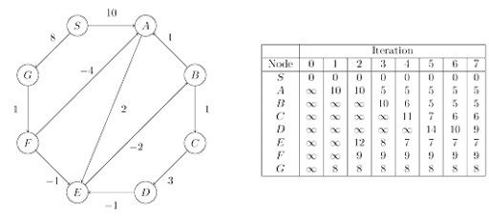
Bellman Ford
Single source shortest path algorithm
Dijkstra must have positive weight
Bellman ford works with negative weights

Slide 3
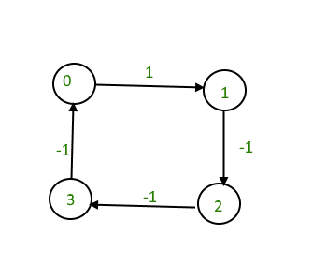
Bellman Ford Steps
If a shortest path exists, it will at most contain N-1 edges where N is the number of nodes
Take all E edges, and apply them to each N edges N-1 times
Apply all edges once more at the end.
If an update is made (more optimal path), then a negative cycle exists and there is no shortest path
O(V * E)

Slide 4
Code Sample
struct Graph* createGraph(int V, int E)
{
struct Graph* graph = new Graph;
graph->V = V;
graph->E = E;
graph->edge = new Edge[E];
return graph;
}
// A utility function used to print the solution
void printArr(int dist[], int n)
{
printf("Vertex Distance from Source\n");
for (int i = 0; i < n; ++i)
printf("%d \t\t %d\n", i, dist[i]);
}
void BellmanFord(struct Graph* graph, int src)
{
int V = graph->V;
int E = graph->E;
int dist[V];
for (int i = 0; i < V; i++)
dist[i] = INT_MAX;
dist[src] = 0;
for (int i = 1; i <= V - 1; i++) {
for (int j = 0; j < E; j++) {
int u = graph->edge[j].src;
int v = graph->edge[j].dest;
int weight = graph->edge[j].weight;
if (dist[u] != INT_MAX && dist[u] + weight < dist[v])
dist[v] = dist[u] + weight;
}
}
for (int i = 0; i < E; i++) {
int u = graph->edge[i].src;
int v = graph->edge[i].dest;
int weight = graph->edge[i].weight;
if (dist[u] != INT_MAX && dist[u] + weight < dist[v]) {
printf("Graph contains negative weight cycle");
return; // If negative cycle is detected, simply return
}
}
printArr(dist, V);
return;
}
#include <bits/stdc++.h>
// a structure to represent a weighted edge in graph
struct Edge {
int src, dest, weight;
};
struct Graph {
int V, E;
struct Edge* edge;
};

Slide 5
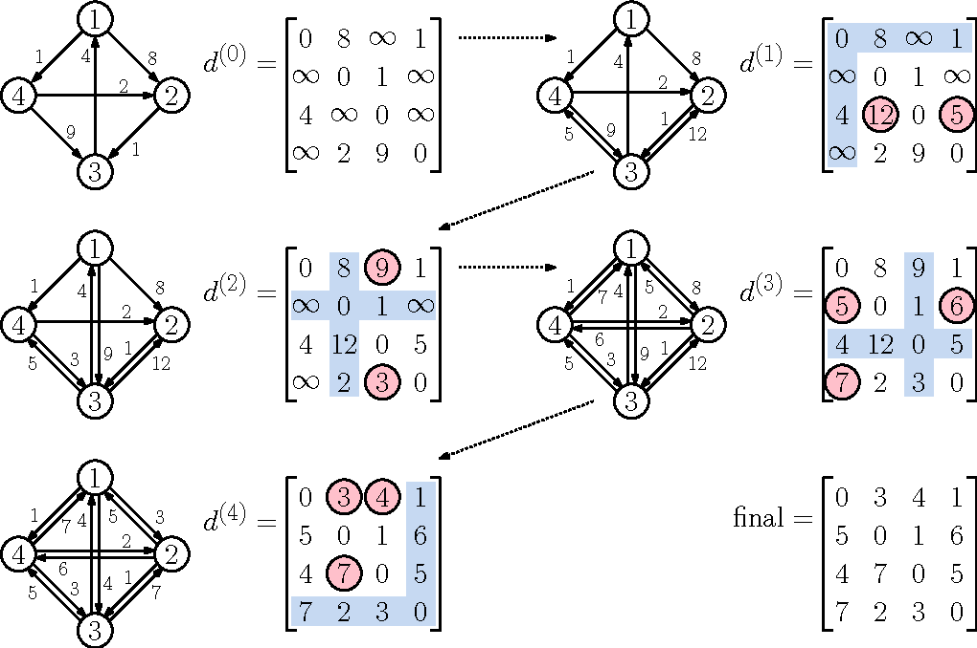
Floyd Warshall
All pairs shortest path. Finds shortest path from every node to every other node
Complexity: O(n^3)
Straightforward implementation

Slide 6
Code Sample
adj[i][j] represents the cost it takes to travel from node i to j (directed)
dis[i][j] represents minimum cost to go from node i to j
Fill dis with infinity
for i = 0; i < n; i++
for j = 0; j < n; j++
if i == j
dis[i][j] = 0
if adj[i][j]
dis[i][j] = adj[i][j]
for k = 0; k < n; k++
for i = 0; i < n; i++
for j = 0; j < n; j++
if dis[i][k]+dis[k][j] < dis[i][j]
dis[i][j] = dis[i][k]+dis[k][j]

Slide 7
More
Another way to find all pairs shortest path:
Johnson’s Algorithm - combination of Bellman-Ford and Dijkstra
Complexity: VE(log V) where V = vertices, and E = edges
When doing all pairs shortest path, you can choose between Floyd Warshall and Johnson’s algorithm depending on the sparseness of the graph (number of edges)

Slide 8
Questions

